Slide 1
The credit department needs to answer the Who, the How the Where and the What of the customer being supplied.
Where?
Who?
How?
The Credit department should look out for the financial stability of the customer to avoid potential losses . Within corporate compliance , the credit department plays an important role.

Slide 2
Without KYC in place, you don’t know who you are dealing with!
transportation company
invoice address
customer
the payment
Company owner
warehouse

Slide 3
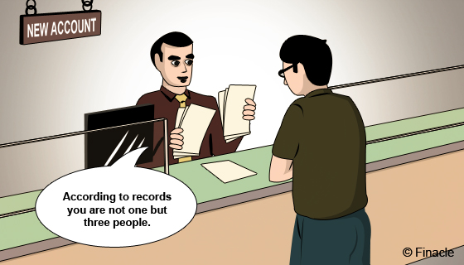
The basis of any compliance policy in relation to Credit & Risk Management is
Know your Customer(KYC)

Slide 4
Know your Customer(KYC)
Customer screening
Who owns the company?
Cross check against directors’ addresses?
Where are the payments coming from?
Where are your goods going to? Sanctions/embargoed countries etc)
What products/services/intellectual property are you providing?
Know your Banking Partner!

Slide 5
Who is paying you?
Are you aware of Money Laundering Regulations?
Corrupt Practices Act?

Slide 6
Customer screening
Who is the decision maker if there is a “hit”?
Screening helps to avoid delays further down the line

Slide 7
End user – Agents/Distributors – more in-depth knowledge required
End user Risks? Who are they selling to? Where are they selling into? End user Certificate required?
Outsourcing

Slide 8
Dealing with 3rd party payments and Reporting mechanisms
Red Flags
Whistle blowing
External Supports

Slide 9
KYC: Possible Red Flags
Customer is evasive or unclear
Someone acting as an “agent”
Dual use of product e.g
A) Products ordered don’t fit the line of business or B) Product incompatible with destination
Customer unfamiliar with product use
Declines routine services (training, maintenance)
Willing to pay cash when terms would be the norm
Abnormal shipping route
Freight forwarder is final destination
Will not supply final destination

